Slide 1








Blockchain Cryptography
Public Key Cryptography, RSA, Encryption, AES, Hashes, Key Derivation, ECC, Digital Signatures
Svetlin Nakov
Principal Technical Trainer
Academy: School of Blockchain
http://academytoken.com

Slide 2

Table of Contents
What is Cryptography?
Cryptographic Hash Functions
HMAC and Key Derivation Functions
Symmetric and Asymmetric Encryption
Cryptographic Secure Random Number Generators (CPSRNG)
Diffie-Hellman Key Exchange (DHKE)
The RSA Cryptosystem: Key Generation, Encrypt, Decrypt
Elliptic Curves and ECDSA: Key Generation, Sign, Verify
Blockchain Cryptography: Wallets, Keys, Addresses, Signatures
Quantum-Safe Cryptography: Hashes, Encryption, Signatures

Slide 3

What is Cryptography?
Encryption, Keys, Hashing, Signatures

Slide 4

What is Cryptography?
Cryptography is the science of providing security and protection of information
Storing and transmitting data in a secure way
Only those, for whom it is intended, can read and process it
Encrypting and decrypting data (symmetric / asymmetric)
Key-exchange algorithms, key derivation
Hashing data (message digest)
Digital signatures (sign / verify)

Slide 5
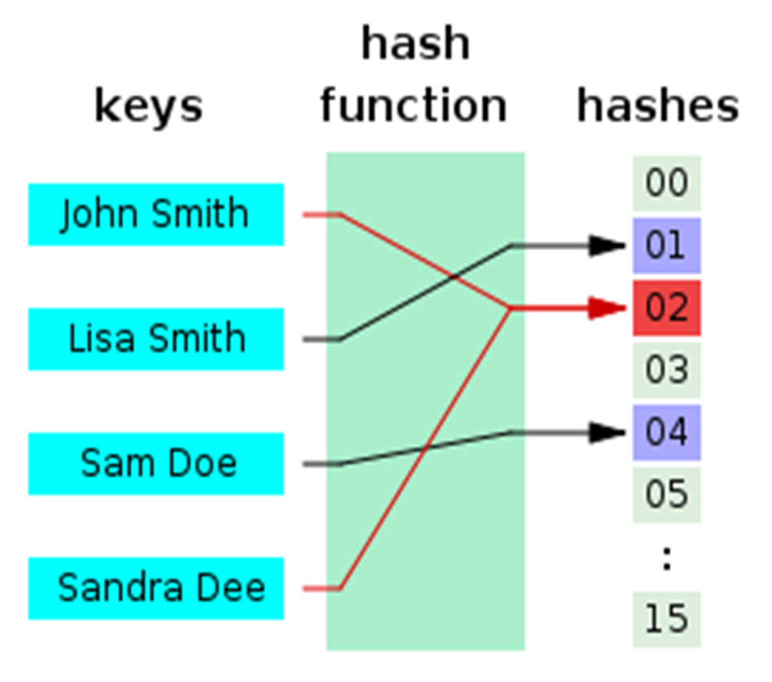
Hashing and Hash Functions
Cryptographic Hash Functions

Slide 6

What is Hashing?
Text
Hashed text
Some text
Some text
Some text
Some text
Some text
Some text
Some text
20c9ad97c081d63397d7b685a412227a40e23c8bdc6688c6f37e97cfbc22d2b4d1db1510d8f61e6a8866ad7f0e17c02b14182d37ea7c3c8b9c2683aeb6b733a1
Hash function

Slide 7
Hash Functions
Hash functions:
Map data of arbitrary size input to result of fixed size
Returned result is called hash value, hash code, digests, or simply hash
Irreversible by design
Cannot reproduce the input from the result
Used in cryptography and in programming

Slide 8
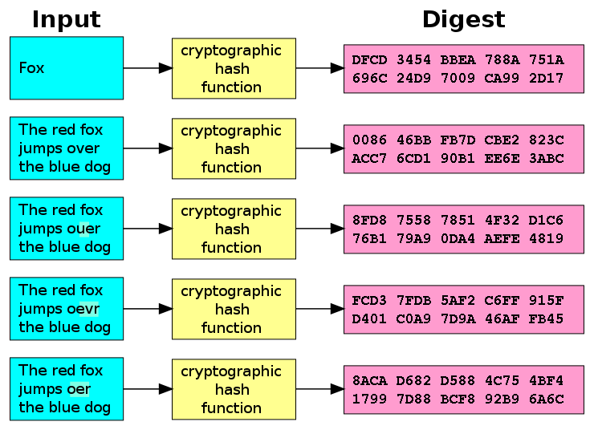
Cryptographic Hash Function
Cryptographic hash function
One-way hash function
Infeasible to invert
Extremely little chance to find a collision
Let's have hash(p)
It should be extremely hard to find an input p', such that hash(p') = p

Slide 9

The Ideal Cryptographic Hash Function
Deterministic
The same message always results in the same hash
Quick
Fast to compute the hash value for any given message
Small change to a message changes totally the hash value
Irreversible
Generate a message from its hash value is infeasible
No significantly better way than brute force (try all messages)
No collisions: cannot find two different messages with the same hash

Slide 10
Cryptographic Hash Functions: Applications
Verifying the integrity of files / documents / messages
E.g. SHA256 checksum may confirm that certain file is original
Password storing and verification
Keep hashed passwords (with salt) in the DB instead in clear text
Generate an almost unique ID of certain document / message
Pseudorandom generation and key derivation
Proof-of-work (PoW) algorithms
Find a number p, such that hash(x + p) holds 10 leading zeroes

Slide 11
Secure Hash Functions
Old hash algorithms: MD5, SHA-0, SHA-1
Withdrawn due to cryptographic weaknesses (collisions found)
SHA-2
Family of functions: SHA-256 (256 bits hash), SHA-512 (512 bits), …
SHA-3
More secure, same hash length (256 bits), known as "Keccak"
RIPEMD-160
Secure hash function, widely used in cryptography, e.g. PGP, Bitcoin
Less secure variations: RIPEMD-128 , RIPEMD-256, RIPEMD-320

Slide 12
Secure Hash Algorithms (2)
BLAKE / BLAKE2 / BLAKE2s / BLAKE2b
Fast, secure cryptographic hash function
256-bit (BLAKE-256, BLAKE2s) and 512-bit (BLAKE-512, BLAKE2b)
As of Mar 2018, no collisions are known for:
SHA256, SHA3-256, Keccak-256, BLAKE2s, RIPEMD160
Brute forcing to find collision costs: 2¹²⁸ for SHA256/SHA3-256 and 2⁸⁰ for RIPEMD160 (2^{256/3} / 2^{160/3} on quantum computer)
* Learn more at: https://z.cash/technology/history-of-hash-function-attacks.html

Slide 13
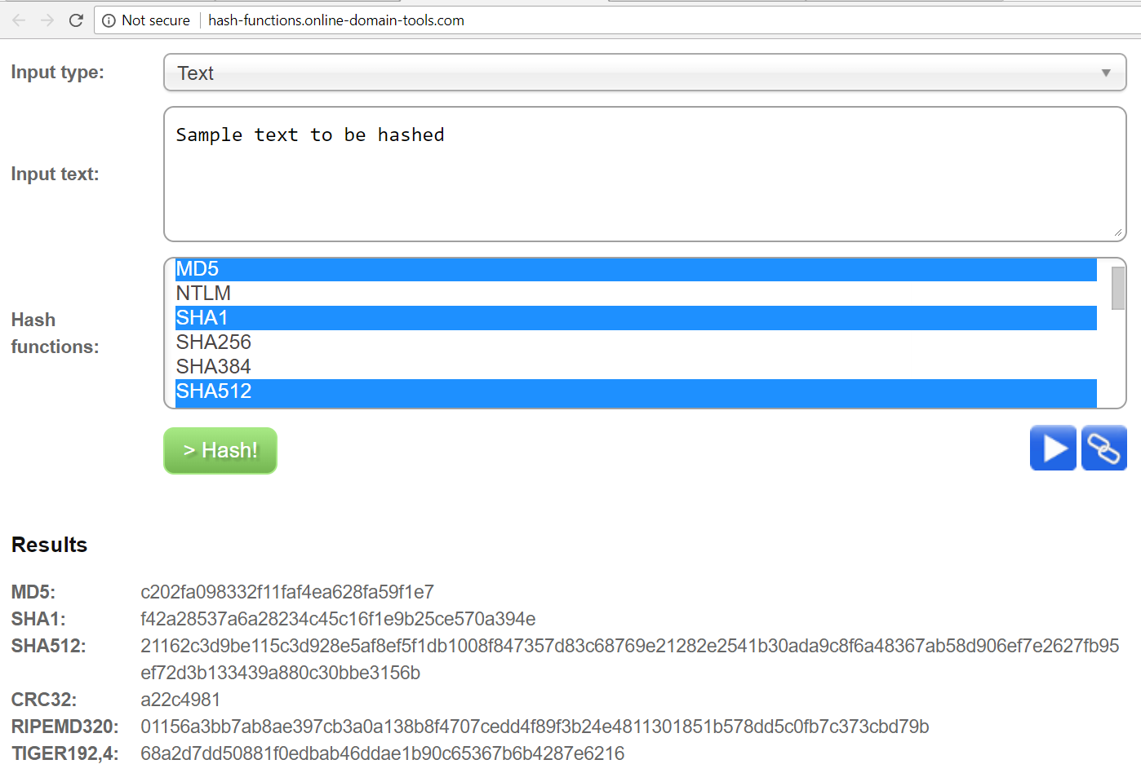
Live Demo
Play with Hash Functions Online
http://hash-functions.online-domain-tools.com

Slide 14
Calculating Hash Functions in Python
import hashlib, binascii
text = 'hello'
data = text.encode("utf8")
sha256hash = hashlib.sha256(data).digest()
print("SHA256: ", binascii.hexlify(sha256hash))
sha3_256 = hashlib.sha3_256(data).digest()
print("SHA3-256: ", binascii.hexlify(sha3_256))
ripemd160 = hashlib.new('ripemd160', data).digest()
print("RIPEMD-160:", binascii.hexlify(ripemd160))

Slide 15
Calculating a Hash Functions in Python (2)
import hashlib
blake2s = hashlib.new('blake2s', data).digest()
print("BLAKE2s: ", binascii.hexlify(blake2s))
# First install "pycryptodome" (https://www.pycryptodome.org)
# pip install pycryptodome
from Crypto.Hash import keccak
keccak256 = keccak.new(data=data, digest_bits=256).digest()
print("Keccak256: ", binascii.hexlify(keccak256))

Slide 16
ETHash
The proof-of-work hash function in the Ethereum blockchain
Memory-intensive hash-function (requires a lot of RAM to be fast)
How does ETHash work?
Seed is computed for each block (based on the entire chain)
From the seed, a 16 MB pseudorandom cache is computed
From the cache, a 1 GB dataset is extracted to be used in mining
Mining involves hashing together random slices of the dataset
* Learn more at: https://github.com/ethereum/wiki/wiki/Ethash

Slide 17
Equihash
The proof-of-work hash function in the Zcash blockchain
Memory-intensive hash-function (requires a lot of RAM to be fast)
How does Equihash work?
Uses BLAKE2b to compute 50 MB hashes from the previous blocks
Solves the "Generalized Birthday Problem" (pick 512 different strings from 2097152, such that the binary XOR of them is zero)
Double SHA256 the solution to compute the final hash
* Learn more at: https://www.cryptolux.org/images/b/b9/Equihash.pdf

Slide 18
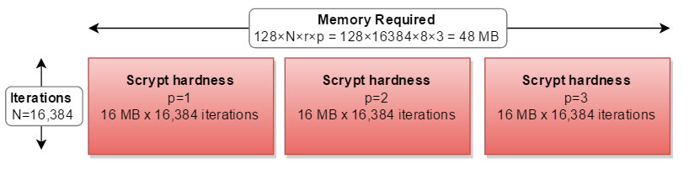
HMAC and Key Derivation
MAC, HMAC, PBKDF2 and SCrypt

Slide 19
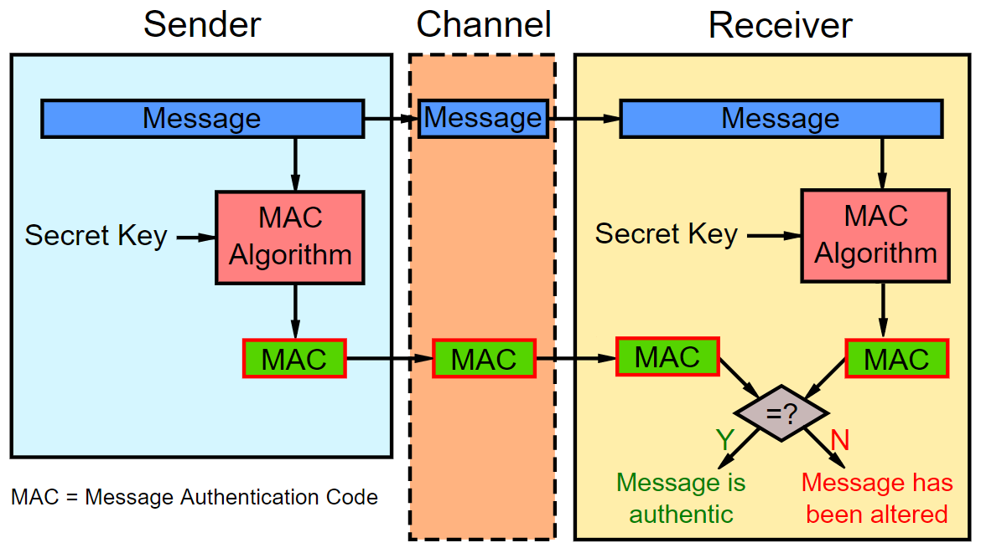
Message Authentication Code (MAC)
Message Authentication Code: auth_code = MAC(key, msg)
Digital authenticity code, like a signature, but with pre-shared key
When we need MAC?
We have a pre-shared key
We get a msg + auth_code
We want to be sure the msg is not tampered (both key and msg are correct)
Pseudo-random generator: next_seed = MAC(salt, seed)

Slide 20
HMAC and Key Derivation
Simply calculating hash_func(key + msg) is insecure
Use a secure HMAC algorithm instead, e.g. HMAC-SHA256
HMAC = Hash-based Message Authentication Code
HMAC(key, msg, hash_func) → hash
Message hash mixed with a secret shared key
Used for message authenticity / integrity / key derivation
Key derivation function (KDF) == function(password) → key
Use HKDF (HMAC-based key derivation), PBKDF2 or SCrypt

Slide 21
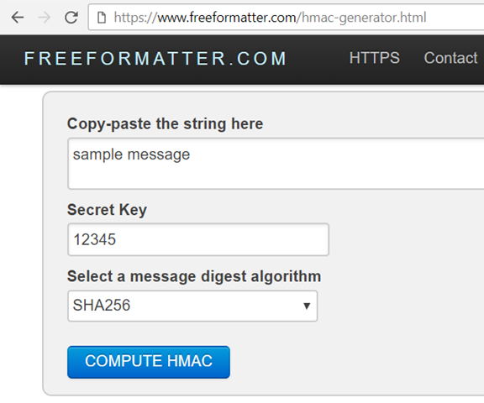
HMAC
Live Demo
https://www.freeformatter.com/hmac-generator.html

Slide 22
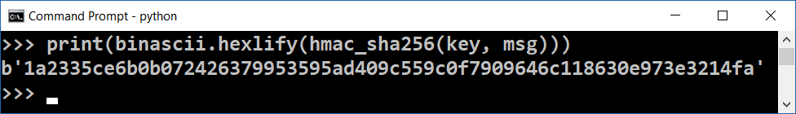
HMAC Calculation in Python – Example
import hashlib, hmac, binascii
def hmac_sha256(key, msg):
return hmac.new(key, msg, hashlib.sha256).digest()
key = binascii.unhexlify("fa63f2b4c85af6bed3")
msg = "some message".encode("utf8")
print(binascii.hexlify(hmac_sha256(key, msg)))

Slide 23
Deriving Encryption Key from Password
Encryption often uses passwords instead of binary keys
A key-derivation function (password → key) is needed
Using SHA-256(password) as key-derivation is insecure!
Brute-force / dictionary / rainbow attacks may reverse the hash
PBKDF2, Bcrypt, Scrypt and Argon2 are significantly stronger
Secure key-derivation functions use salt + many iterations
It takes CPU time to derive the key (e.g. 0.2 sec) + memory (RAM)
Cracking passwords will be slow (e.g. 5-10 attempts / second)

Slide 24
Key Derivation Functions: PBKDF2
PBKDF2 is a simple cryptographic key-derivation function
Based on iteratively deriving HMAC many times
Described in RFC 2898 (PKCS #5) – http://ietf.org/rfc/rfc2898.txt
Input data for PBKDF2:
password – array of bytes / string, e.g. "p@$$w0rD~3"
salt – securely-generated random bytes, e.g. "dfc66e9c5…1b63"
iterations count, e.g. 1024 iterations
hash-function for HMAC, e.g. SHA256
derived-key-len for the output, e.g. 256 bits

Slide 25
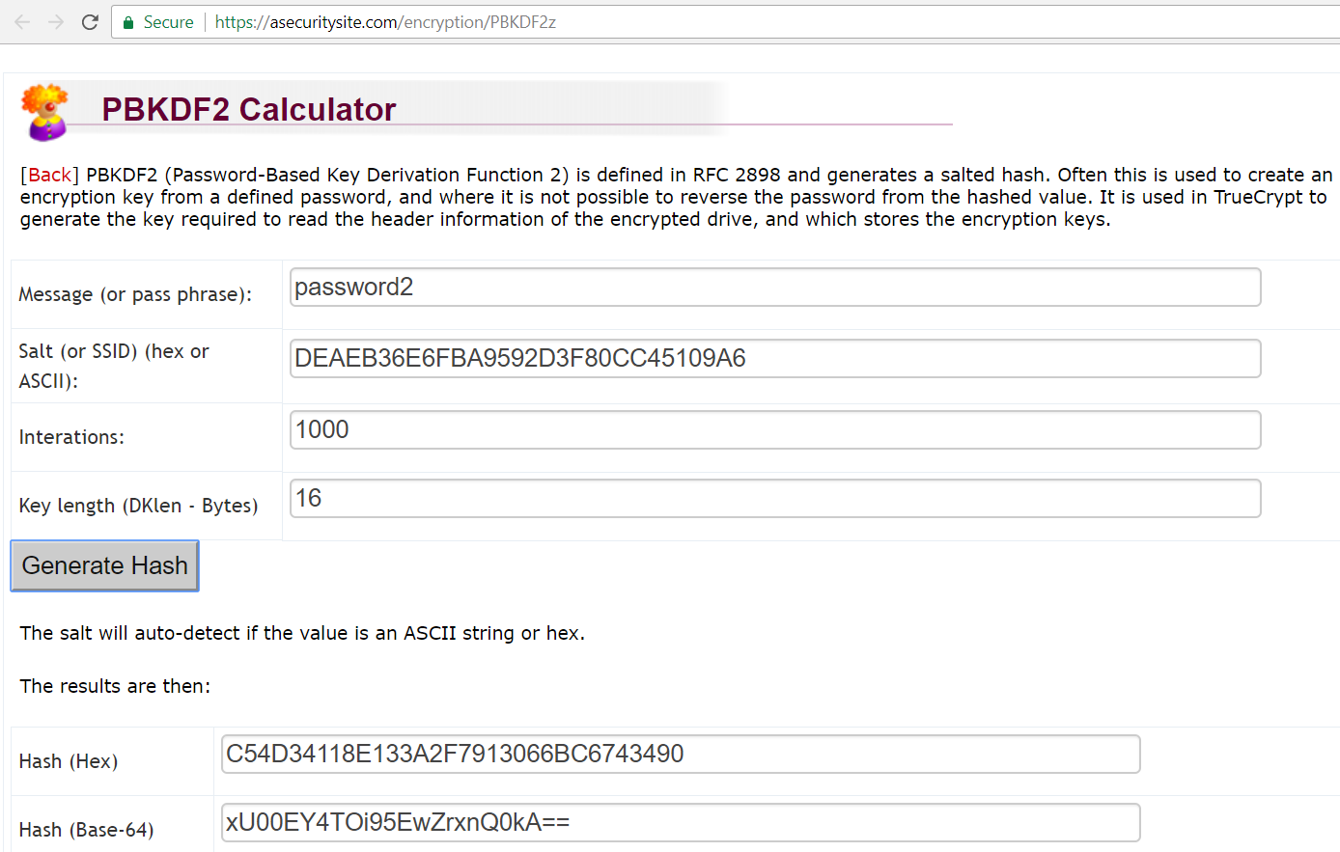
PBKDF2 Key Derivation
Live Demo
https://asecuritysite.com/encryption/PBKDF2z

Slide 26
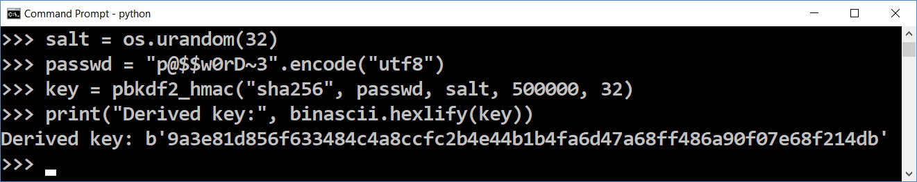
PBKDF2 Key Derivation in Python – Example
import os, binascii
from backports.pbkdf2 import pbkdf2_hmac
salt = os.urandom(32)
passwd = "p@$$w0rD~3".encode("utf8")
key = pbkdf2_hmac("sha256", passwd, salt, 500000, 32)
print("Derived key:", binascii.hexlify(key))
pip install backports.pbkdf2

Slide 27
Key Derivation Functions: Scrypt
Scrypt (RFC 7914) is a strong cryptographic key-derivation function
Memory intensive, designed to prevent ASIC and FPGA attacks
key = Scrypt(password, salt, N, r, p, derived-key-len)
N – iterations count (affects memory and CPU usage), e.g. 16384
r – block size (affects memory and CPU usage), e.g. 8
p – parallelism factor (threads to run in parallel), usually 1
Memory used = 128 * N * r * p bytes, e.g. 128 * 16384 * 8 = 16 MB
Parameters for interactive login: N=16384, r=8, p=1 (RAM=16MB)
Parameters for file encryption: N=1048576, r=8, p=1 (RAM=1GB)

Slide 28
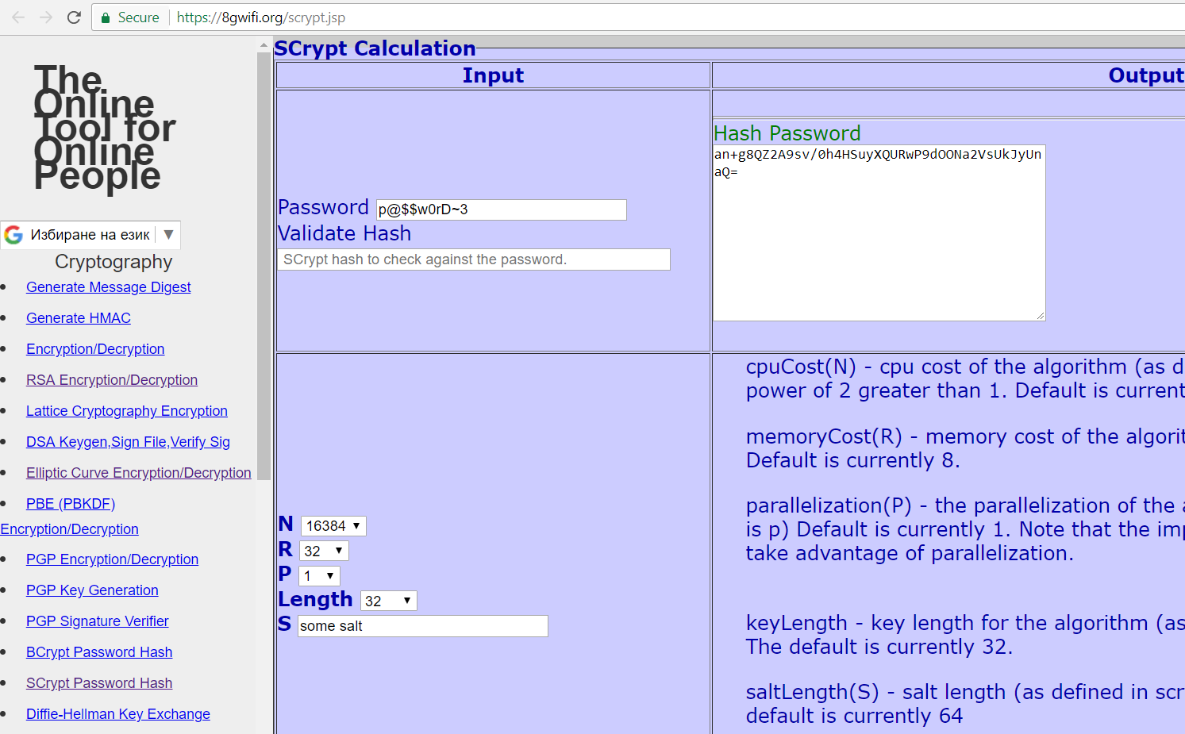
Scrypt Key Derivation
Live Demo
https://8gwifi.org/scrypt.jsp

Slide 29
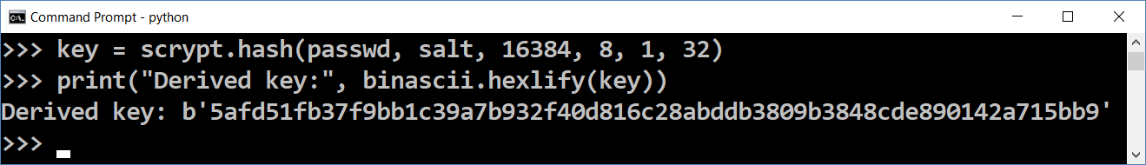
Scrypt Key Derivation in Python – Example
import scrypt, os, binascii
passwd = "p@$$w0rD~3"
salt = os.urandom(32)
print("Salt: ", binascii.hexlify(salt))
key = scrypt.hash(passwd, salt, 16384, 8, 1, 32)
print("Derived key:", binascii.hexlify(key))
pip install scrypt

Slide 30

Symmetric / Asymmetric Encryption
Symmetric Encryption
Asymmetric Encryption
vs.

Slide 31
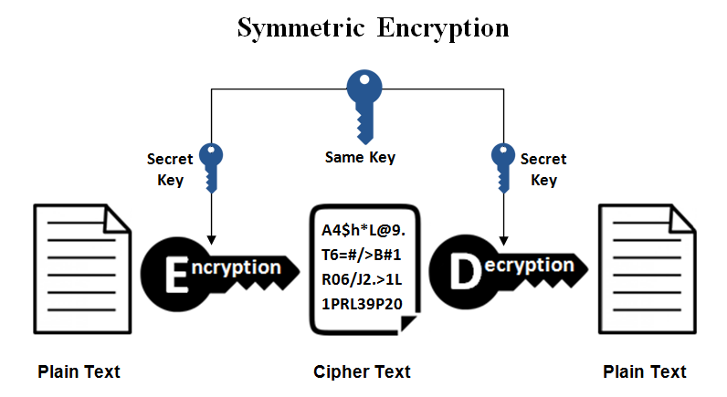
Symmetric Encryption
A single secret key to cipher / decipher
The secret key can be a number or string
Both the sender and the recipient should know the secret key
Widely used symmetric algorithms: AES-128, AES-256, Twofish, IDEA

Slide 32
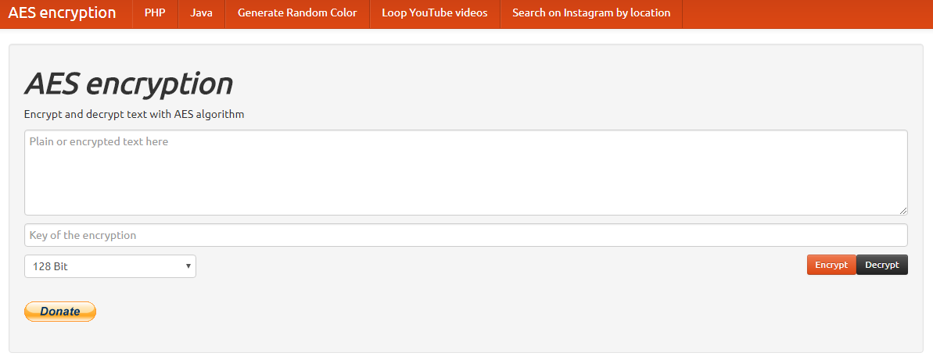
Live Demo
AES Encrypt / Decrypt: https://aesencryption.net

Slide 33
AES Cipher Settings
AES is a "block cipher" – encrypts block by block (e.g. 128 bits)
It has several modes of operation (CBC, ECB, CTR, …)
Some modes of operation require initial vector (IV)
Non-secret random salt → used to get different result each time
Recommended modes: CBC (Cipher Block Chaining), CTR (Counter)
It may use a padding algorithm (typically PKCS7) to split the input data into blocks of fixed block-size (e.g. 128 bits)
It may use password to key derivation function, e.g. Scrypt(passwd)
It may use MAC to check the password validity, e.g. HMAC(text, key)

Slide 34
Example: AES Encrypt / Decrypt in Python
import pyaes, pbkdf2, binascii, os, secrets
plaintext = "Sample text for encryption"
password = "s0m3p@$$w0rd"
key = pbkdf2.PBKDF2(password, 'some salt').read(16)
print('AES encryption key:', binascii.hexlify(key))
iv = secrets.randbelow(2 << 128)
aes = pyaes.AESModeOfOperationCTR(key, pyaes.Counter(iv))
ciphertext = aes.encrypt(plaintext)
print('encrypted:', binascii.hexlify(ciphertext))
aes = pyaes.AESModeOfOperationCTR(key, pyaes.Counter(iv))
decrypted = aes.decrypt(ciphertext)
print('decrypted:', decrypted)
pip install pyaes
pip install pbkdf2

Slide 35
Ethereum UTC / JSON Wallet Encryption
{ "version": 3, "id": "…", "address": "b97e993872a9050c07f…ef195",
"Crypto": {
"ciphertext": "bc9215b2cd1571df…e3a1", // the encrypted private key
"cipher": "aes-128-ctr", // AES, 128-bit encryption, CTR mode
"cipherparams": { "iv": "2bac08cafc…8e" }, // random initial vector
"kdf": "scrypt", "kdfparams": {
"dklen": 32, // key length (256-bit key for AES encryption)
"salt": "7d48230c94b90c0301bf9f4…eba1", // random-generated salt
"n": 1024, // iterations count (CPU + memory cost factor)
"r": 8, // block size (affects CPU + memory)
"p": 1 // parallelization factor (threads count)
},
"mac": "e3cd7ea4e3ceb0e9a…0564" // msg integrity key (password check)
} }
Learn more at: https://github.com/ethers-io/ethers.js/blob/master/wallet/secret-storage.js#L288

Slide 36
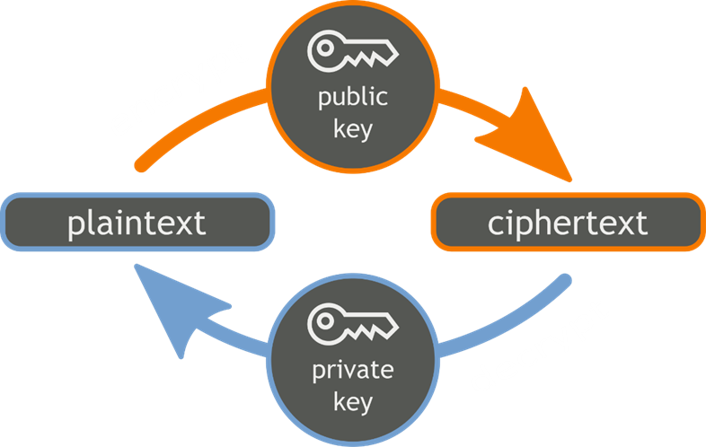
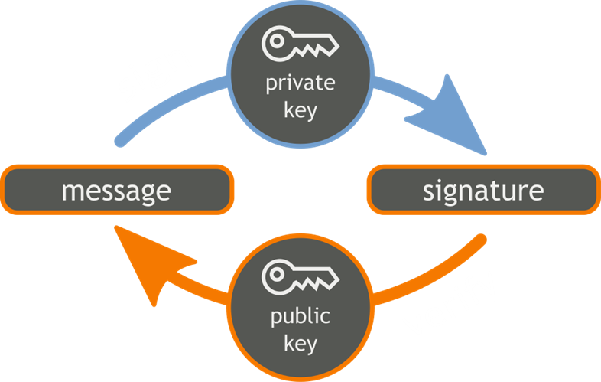
Public Key Cryptography
Uses a pair of keys: public key + private key
Encrypt / sign by private key
Decrypt / verify by public key

Slide 37
Public Key Crypto Systems
Well-known public-key crypto-systems
RSA – based on discrete logarithms
ECDSA – based on elliptic curves (ECC)
3072-bit RSA key ≈≈ 256-bit ECC key
ECC cryptography is considered more secure
Most blockchains (like Bitcoin and Ethereum) use ECC
Still, it is not quantum-safe!

Slide 38
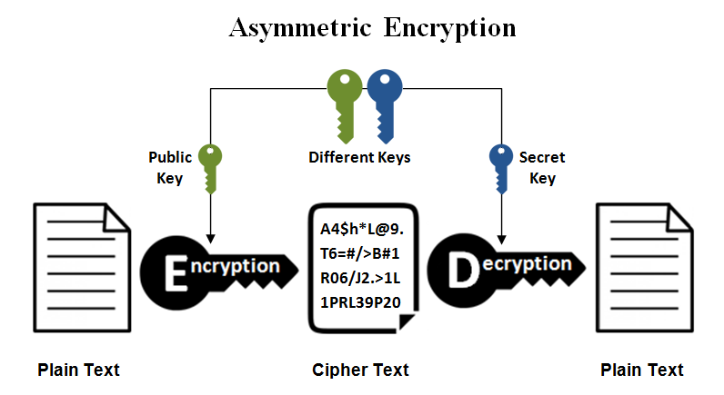
Asymmetric Encryption
Public-key cryptography:
Use public / private keys to encrypt / decrypt data
The public key can be shared with everyone
The private key is kept secret
Encrypt a message using the public key
Decrypt the message only with the private key
Popular asymmetric algorithms: RSA, EIGamal, DSA, Elliptic Curve DSA

Slide 39
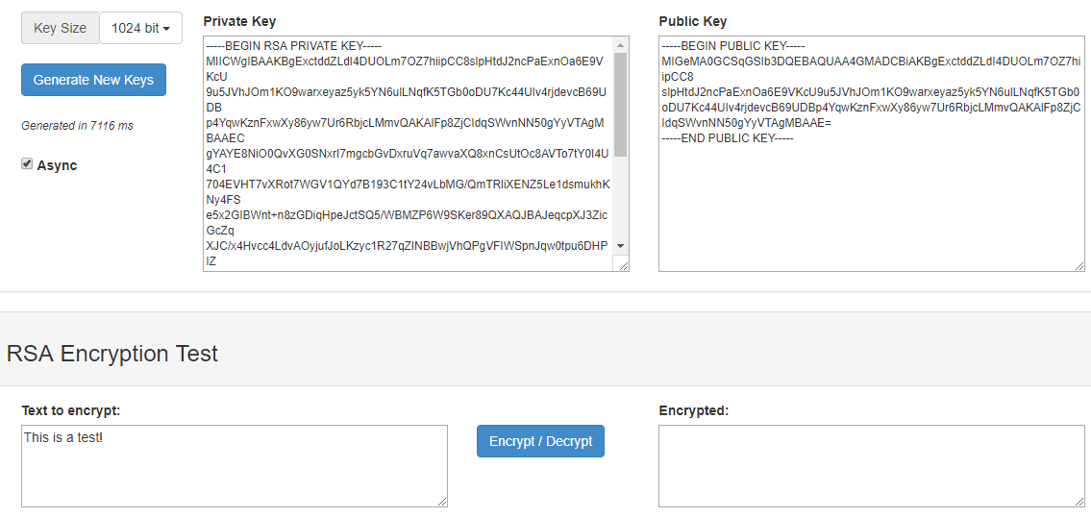
Live Demo
JSEncrypt (Generate RSA Keys and Encrypt): http://travistidwell.com/jsencrypt/demo/

Slide 40
RSA Cipher Settings
The RSA cryptosystem uses public / private key pair
Public key: modulus n (big integer) + exponent e (usually 65537)
Private key: secret exponent d (big integer)
Key length: 1024 (weak), 2048, 4096, …, 16384 or more bits
RSA can encrypt data of size limited by the key length
Usually, encrypt a symmetric key (AES) → protect data of any size
PKCS#1 (RFC 8017) defines the recommendations for:
Public-key cryptography based on the RSA algorithm
Optimal Asymmetric Encryption Padding (OAEP)

Slide 41
Example: RSA Encrypt / Decrypt in Python
from Crypto.PublicKey import RSA
from Crypto.Cipher import PKCS1_OAEP
import binascii
keyPair = RSA.generate(2048)
pubKey = keyPair.publickey()
print(f"Public key: (mod={pubKey.n}, exp={pubKey.e})")
print("Private key:", keyPair.d)
encryptor = PKCS1_OAEP.new(pubKey)
encrypted = encryptor.encrypt(b'Some message')
print("Encrypted:", binascii.hexlify(encrypted))
decryptor = PKCS1_OAEP.new(keyPair)
decrypted = decryptor.decrypt(encrypted)
print('Decrypted:', decrypted)
pip install pycryptodome

Slide 42


Exercises
Key-Derivation, HMAC, AES Encrypt / Decrypt

Slide 43
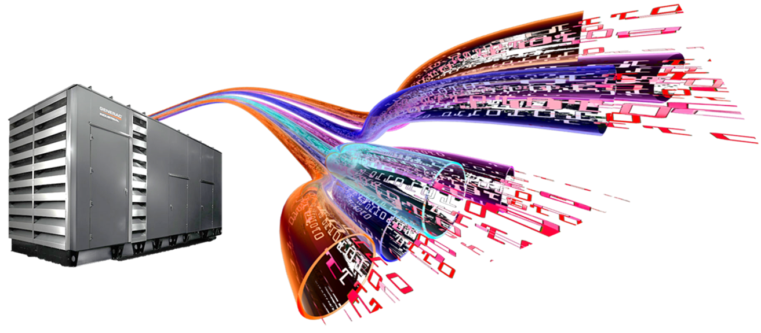
Random Number Generators
Cryptographic Secure Random (CSPRNG)

Slide 44
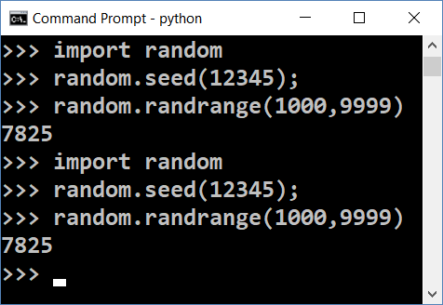
Random Generators and Cryptography
In computer science random numbers come from a pseudo-random number generator (PRNG)
Consists of initial entropy (seed) + pseudo-random function
To be secure, a PRNG should start by a truly random initial seed
Known seed generates predictable random numbers → insecure
! insecure !
Insecure randomness can compromise cryptography
The stolen Bitcoins story: https://goo.gl/PFE1kr

Slide 45
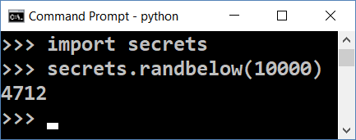
Secure Random Generators (CSPRNG)
Cryptography secure random generators (CSPRNG) guarantee that the random numbers are absolutely unpredictable
E.g. hardware devices (TRNG) capturing physical processes
CSPRNG should start from a truly random seed
Modern OS collect entropy (seed) from keyboard clicks, mouse moves, network activity, etc.
Accessible from /dev/random and /dev/urandom
In Python use the secrets library

Slide 46
Internal Seed in Crypto Wallets
Most modern crypto wallets start from a 128 / 256 bits securely generated random seed (see the BIP-39 standard)
The seed (root key) can be represented by 12 or 24 words, e.g.
Each word comes from a wordlist of 2048 words
See https://github.com/bitcoin/bips/blob/master/bip-0039/english.txt
1 word == 11 bits
12 words == 132 bits == 128-bit seed + checksum (in the last word)
24 words == 264 bits == 256-bit seed + checksum (in the last word)
hill brave science fox crime quit owner chapter myth vocal chat custom

Slide 47
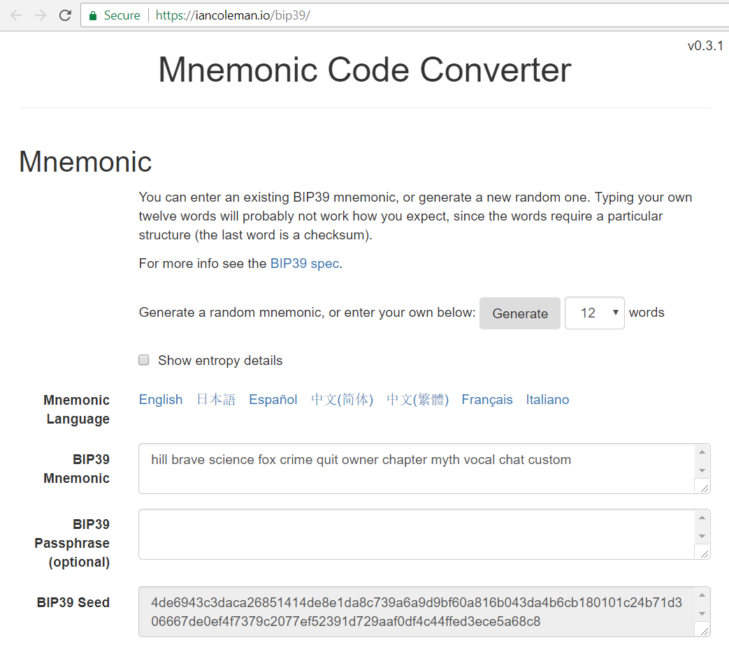
BIP-39 Mnemonic Seed Generator
Live Demo
https://iancoleman.io/bip39

Slide 48
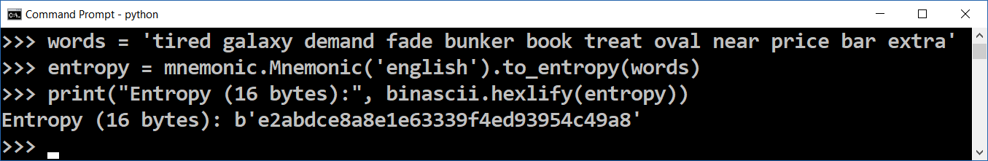
Mnemonic to Entropy / Seed
import mnemonic, binascii
words = 'tired galaxy demand fade bunker book treat oval near price bar extra'
entropy = mnemonic.Mnemonic('english').to_entropy(words)
print("Entropy (16 bytes):", binascii.hexlify(entropy))
seed = mnemonic.Mnemonic.to_seed(words)
print("Seed (64 bytes):", binascii.hexlify(seed))
wordsBack = mnemonic.Mnemonic('english').to_mnemonic(entropy)
print("Mnemonic (12 words):", wordsBack)
pip install mnemonic

Slide 49
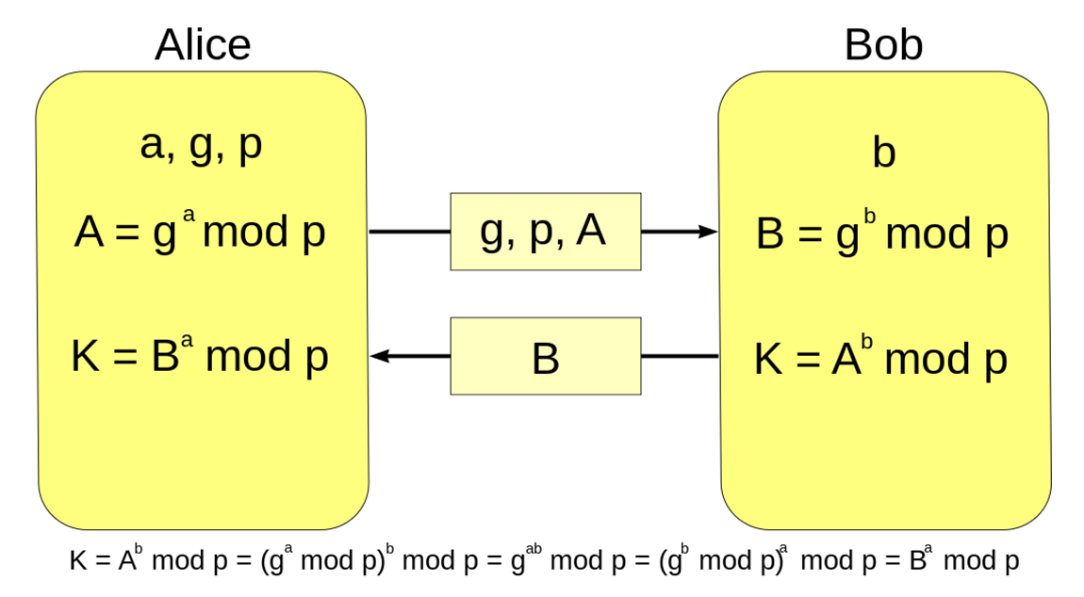
Diffie-Hellman Key Exchange (DH)
Diffie-Hellman and Module Arithmetic

Slide 50

Diffie–Hellman Key Exchange (DH)
Securely exchanging cryptographic keys
Over a public (insecure) channel
One of the first public-key protocols
Allows two parties to exchange data securely
The Diffie–Hellman (DH) method allows
Two parties that have no prior knowledge of each other
Jointly establish a shared secret key over an insecure channel

Slide 51
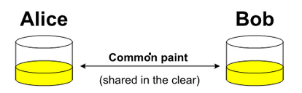
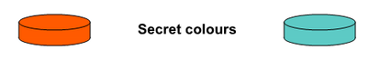
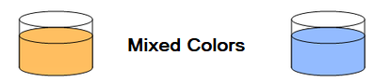
Key Exchange by Mixing Colors
Alice and Bob, agree on an arbitrary starting color that does not need to be kept secret
Each of them selects a secret color that they keep to themselves
Finally Alice and Bob mix their secret color together with their mutually shared color

Slide 52
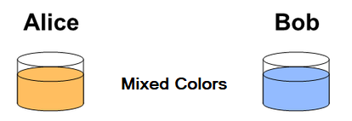
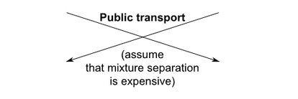
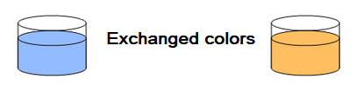
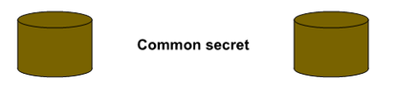
Key Exchange by Mixing Colors (2)
Publicly exchange the two mixed colors
Finally, each of the two mix together the color they received from the partner with their own private color
The result is a final color mixture yellow-brown that is identical to the partner's color mixture
If a third party listened to the exchange, it would be computationally difficult for them to determine the secret colors

Slide 53
DH Key Exchange: Modular Arithmetic
Alice and Bob agree to use a modulus p = 23 and base g = 5
Alice chooses a secret integer a = 4, then sends Bob A = gª mod p
A = 5⁴ mod 23 = 4
Bob chooses a secret integer b = 3, then sends Alice B = g^{b} mod p
B = 5³ mod 23 = 10
Alice computes s = Bª mod p
s = 10⁴ mod 23 = 18
Bob computes s = A^{b} mod p
s = 4³ mod 23 = 18
Alice and Bob now share a secret number s
s = (gª)^{b} mod p = (g^{b})ª mod p
s = 18
s cannot be computed from A and B
Video: youtu.be/M-0qt6tdHzk

Slide 54
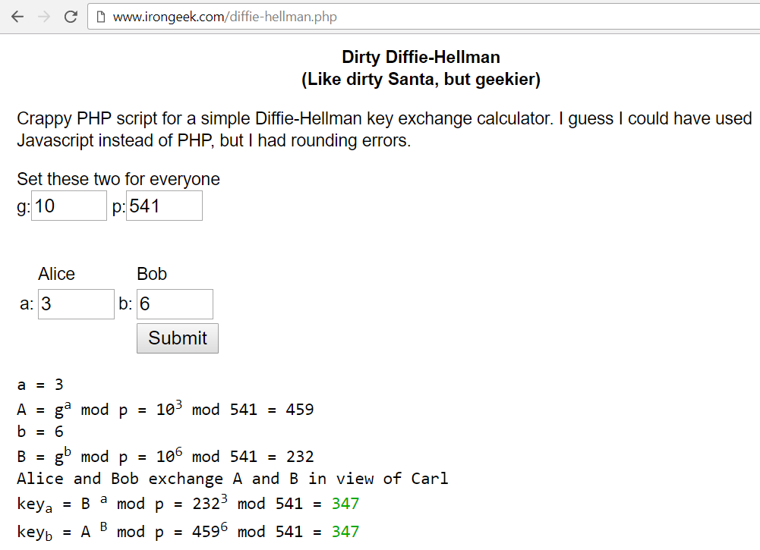
Diffie-Hellman Key Exchange
Live Demo
http://www.irongeek.com/diffie-hellman.php

Slide 55
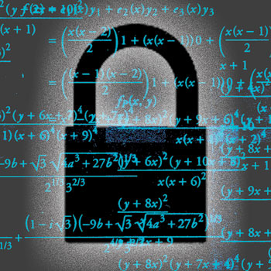
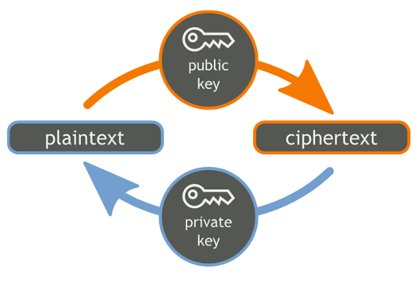
RSA Cryptography
RSA
RSA Key Generation, Encryption, Decryption

Slide 56
RSA Cryptography
RSA (Rivest–Shamir–Adleman) is public-key cryptosystem
Based on big integers and modular exponentiation
Developed by MIT, widely used in computer cryptography
Generate RSA public / private key pair
Find very large integers e, d and n, such that:
(m^{e})^{d} ≡ m (mod n) for all m for 0 ≤ m < n
public key = {n, e} → shared with everyone
private key = {n, d} → secret, cannot be calculated from {n, e}

Slide 57


RSA Cryptography: Encrypt / Decrypt
Encrypt a message with RSA public key {n, e}
encrypted = (message)^{e} mod n
Decrypt a message with RSA private key {n, d}
message = (encrypted)^{d} mod n
Recall that (m^{e})^{d} ≡ m (mod n)
No efficient algorithm exists for integer factorization
If you are given n, you cannot find its factorization n = p*q
No efficient algorithm to calculate {n, d} from {n, e}

Slide 58
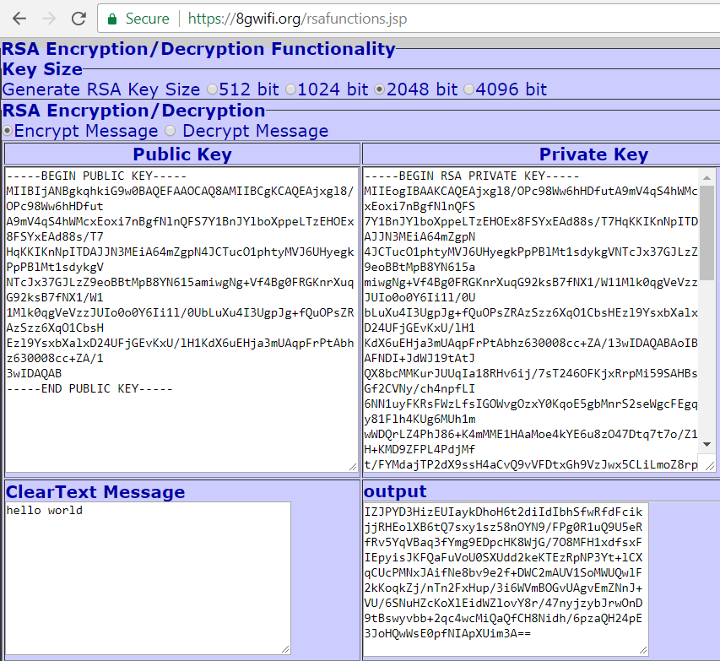
RSA Encrypt and Decrypt
Live Demo
https://8gwifi.org/rsafunctions.jsp

Slide 59
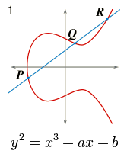
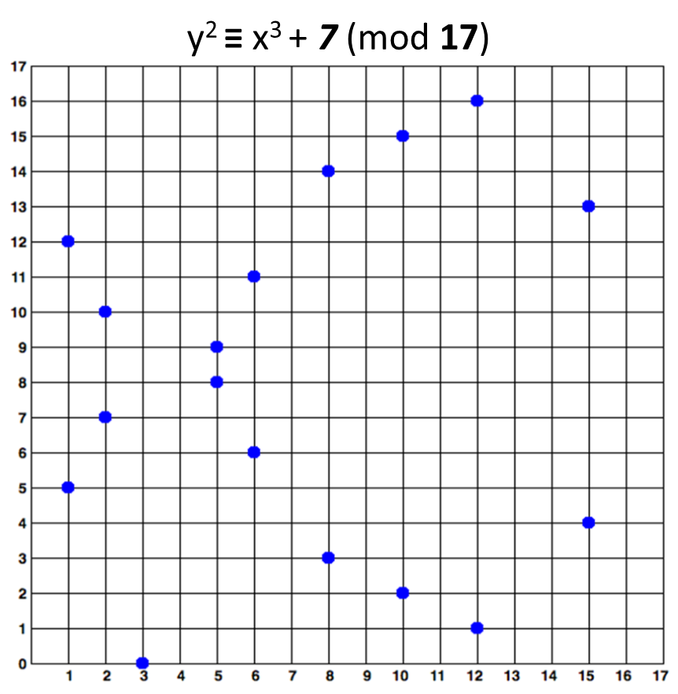
Elliptic Curve Cryptography (ECC)
Elliptic Curves, ECC and ECDSA, Sign, Verify

Slide 60
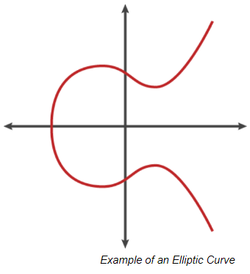
Elliptic Curve Cryptography (ECC)
Public / private key cryptography based on the algebraic structure of elliptic curves over finite fields
Requires smaller key-size than RSA for the same security strength
Elliptic curves == set of points {x, y} such that:
y² = x³ + ax + b
Example – the Bitcoin elliptic curve:
y² = x³ + 7 (a = 0; b = 7)

Slide 61
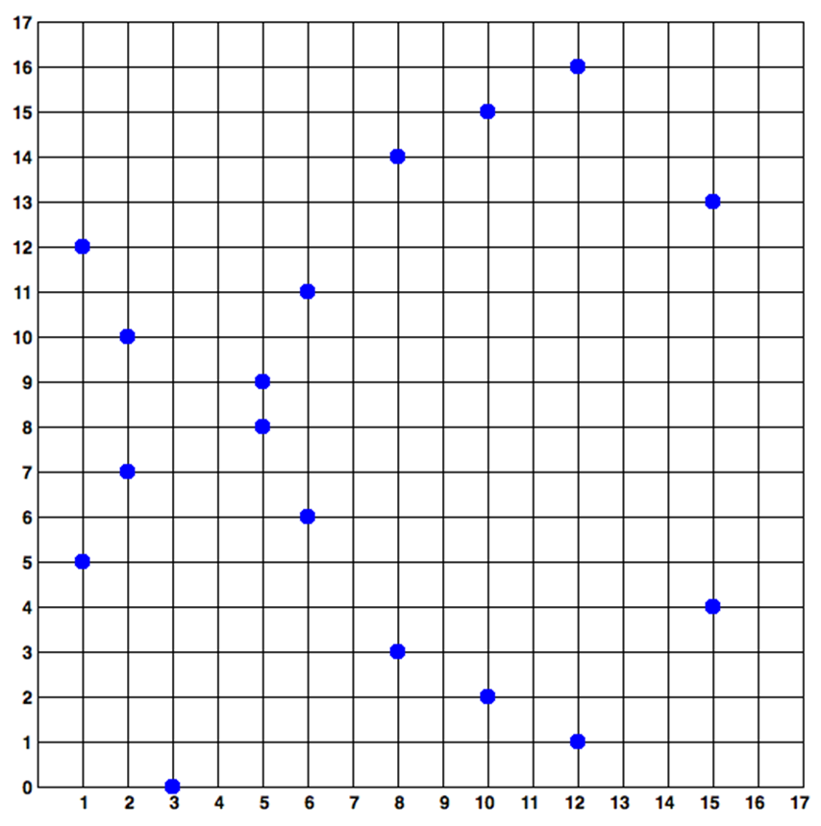
Elliptic Curves over a Finite Fields
Elliptic curves cryptography (ECC)
Uses ecliptic curves over the finite field F_{p} (p is prime, p > 3)
A set of integer coordinates {x, y}, such that 0 ≤ x, y < p
Staying on the elliptic curve: y² ≡ x³ + ax + b (mod p)
Example of elliptic curve over F₁₇:
y² ≡ x³ + 7 (mod 17)
y² ≡ x³ + 7 (mod 17)

Slide 62
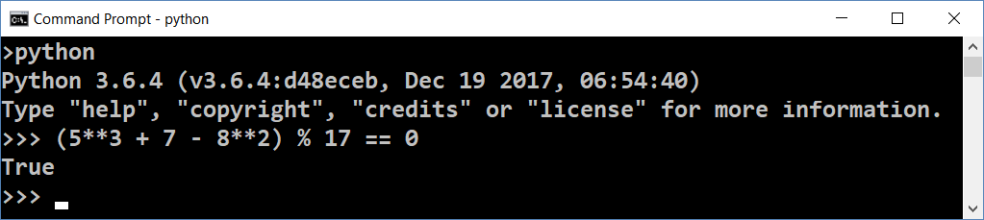
Calculating Elliptic Curves over Finite Fields
y² ≡ x³ + 7 (mod 17)
The point P(5, 8) is on the curve y² = x³ + 7 over the finite field F₁₇
(x³ + 7 - y²) ≡ 0 (mod 17)
(5**3 + 7 - 8**2) % 17 == 0
P

Slide 63
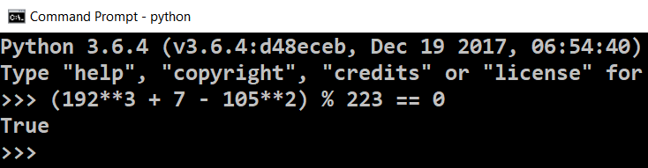
Exercise: Elliptic Curves over Finite Fields
Problem: True or False?
Point is on the y² = x³ + 7 curve over F₂₂₃
(192, 105)
(17, 56)
(200, 119)
(1, 193)
(42, 99)
Solution of y²=x³+7 curve over F₂₂₃
Just calculate the expression:
(192**3 + 7 - 105**2) % 223 == 0

Slide 64
Multiply a Point Over an Elliptic Curve
y² ≡ x³ + 7 (mod 17)
A point G over the curve can be multiplied by an integer k
P = k * G
The result is another point P staying on the same curve
k == private key (integer)
P == public key (point)
Very fast to calculate P = k * G
Extremely slow (considered infeasible) to calculate k = P / G
P
G

Slide 65
Example: Multiply Points Over Elliptic Curves
Elliptic curve point multiplication is done by well-known algorithms
Sample elliptic curve:
y² ≡ x³ + 7 (mod 17)
a = 0; b = 7; p = 17
Let G = (15, 13)
G₂ = 2 * G = (2, 10)
G₃ = 3 * G = (8, 3)
y² ≡ x³ + 7 (mod 17)
G
G₂
G₃

Slide 66
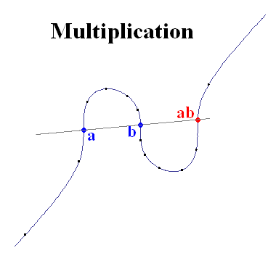
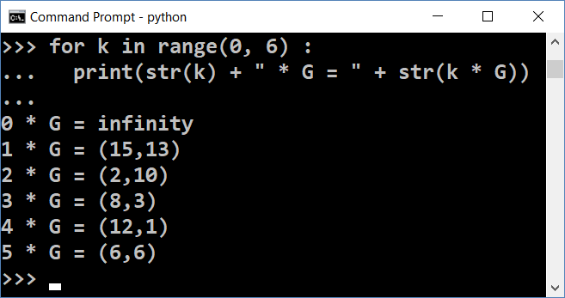
Elliptic Curves Multiplication in Python
pip install pycoin
from pycoin.ecdsa import Point
from pycoin.ecdsa import CurveFp
curve = CurveFp(17, 0, 7)
print("Curve = " + str(curve))
G = Point(curve, 15, 13)
print("G = " + str(G))
for k in range(0, 6) :
print(str(k) + " * G = " + str(k * G))

Slide 67
Compressing the Public Key
The elliptic curves over F_{p}
Have at most 2 points per y coordinate (odd x and even x)
A public key P(x, y) can be compressed as C(x, odd/even)
At the curve y² ≡ x³ + 7 (mod 17)
P(10, 15) == C(10, odd)
mod_sqrt(x³ + 7, 17) == y || 17 - y
y² ≡ x³ + 7 (mod 17)

Slide 68
Compressing a Public Key in Python
from pycoin.ecdsa import CurveFp, Point
from nummaster.basic import sqrtmod
def compress_key_pair(key_pair):
return (key_pair.x(), key_pair.y() % 2)
def uncompress_key(curve, compressed_key):
x, is_odd = compressed_key
p, a, b = curve.p(), curve.a(), curve.b()
y = sqrtmod(pow(x, 3, p) + a * x + b, p)
if bool(is_odd) == bool(y & 1):
return (x, y)
return (x, p - y)
pip install nummaster

Slide 69
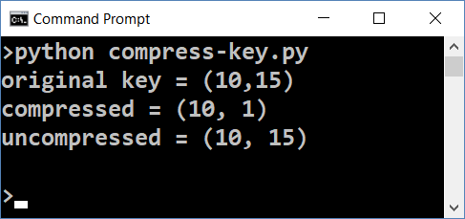
Compressing a Public Key in Python (2)
curve = CurveFp(17, 0, 7)
p = Point(curve, 10, 15)
print(f"original key = {p}")
compressed_p = compress_key_pair(p)
print(f"compressed = {compressed_p}")
restored_p = uncompress_key(curve, compressed_p)
print(f"uncompressed = {restored_p}")

Slide 70
ECC Parameters and secp256k1
ECC operates with a set of EC domain parameters:
T = (p, a, b, G, n, h)
Prime field (prime p), elliptic equation (a, b), base point G(x_{G}, y_{G}), order of G (prime n), cofactor (h)
The secp256k1 standard (used in Bitcoin) defines 256-bit elliptic-curves cryptosystem:
Prime field (p) = 2²⁵⁶ - 2³² - 977; Equation: y² = x³ + 7 (a = 0, b = 7)
G = 0x79BE667E …; n = 0xFFF…D0364141; h = 1
Learn more at: http://www.secg.org/sec2-v2.pdf, https://en.bitcoin.it/wiki/Secp256k1

Slide 71
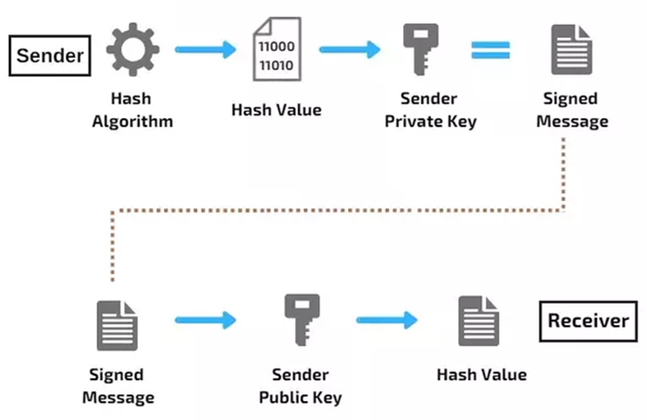
What is a Digital Signature?
Digital signature
Cryptographic prove for message authenticity
Authentication
Signed by certain private key
Verified by the corresponding public key
Non-repudiation
The sender cannot deny the signing later
Integrity
The message cannot be altered after signing

Slide 72
ECDSA: Sign Messages and Verify Signatures
The Elliptic-Curves Digital Signature Algorithm (ECDSA) provides signing by private key + verifying signature by public key
Signing a message
sign(private_key, msg) → signature (the signature is EC point)
Performs some math, based on elliptic curve calculations
Verifying a message signature
verify(public_key, msg, signature) → true / false
Performs some math, based on elliptic curve calculations

Slide 73
Example: ECDSA in Python – Sign a Message
from pycoin.ecdsa import generator_secp256k1, sign, verify
import hashlib
def keccak_hash(msg) :
hash_bytes = hashlib.sha3_256(msg.encode("utf8")).digest()
return int.from_bytes(hash_bytes, byteorder="big")
msg = "some message"
msg_hash = keccak_hash(msg)
private_key = 9999999999999999999999999999999999999999999
signature = sign(generator_secp256k1, private_key, msg_hash)
print("signature = " + str(signature))

Slide 74
Example: ECDSA in Python – Verify a Signature
public_key = (generator_secp256k1 * private_key).pair()
print("public key: " + str(public_key))
valid = verify(generator_secp256k1,
public_key, msg_hash, signature)
print("Signature valid? " + str(valid))
tampered_msg_hash = keccak_hash("tampered msg")
valid = verify(generator_secp256k1, public_key,
tampered_msg_hash, signature)
print("Signature (tampered msg) valid? " + str(valid))

Slide 75
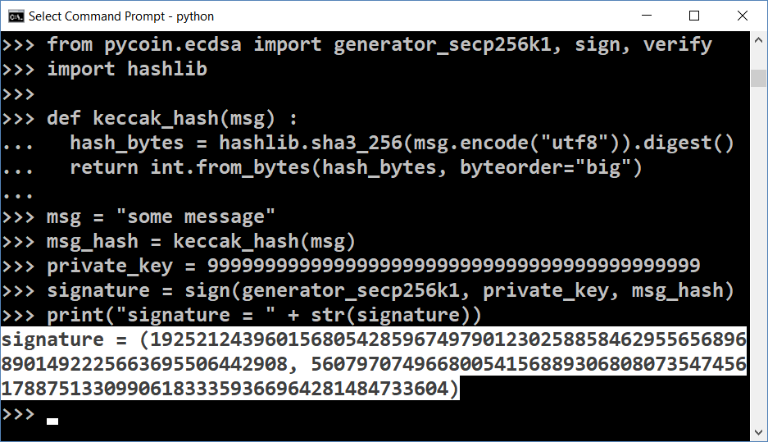
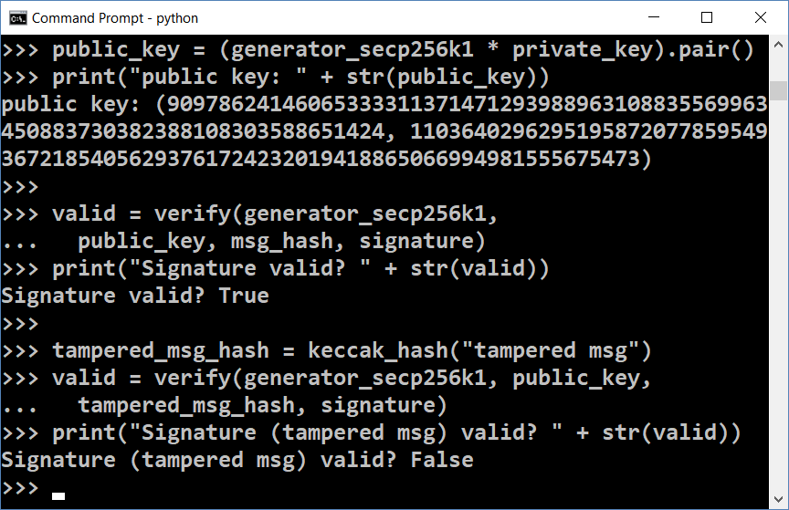
ECDSA: Sign / Verify Signature
Live Demo

Slide 76
Ethereum Addresses and secp256k1
The private key in secp256k1 is 256-bit integer (32 bytes)
Example of Ethereum private key (encoded as 64 hex digits)
The public key is a EC point (2 * 256 bits == 64 bytes)
Can be compressed to 257 bits (Ethereum uses prefix 02 or 03)
Example of compressed public key (33 bytes / 66 hex digits):
97ddae0f3a25b92268175400149d65d6887b9cefaf28ea2c078e05cdc15a3c0a
7b83ad6afb1209f3c82ebeb08c0c5fa9bf6724548506f2fb4f991e2287a77090 177316ca82b0bdf70cd9dee145c3002c0da1d92626449875972a27807b73b42e
027b83ad6afb1209f3c82ebeb08c0c5fa9bf6724548506f2fb4f991e2287a77090

Slide 77
ECDSA, secp256k1 and Ethereum (2)
The blockchain address in Ethereum is 20 bytes
Calculated as: last20bytes(keccak256(publicKeyFull))
Example of Ethereum address (encoded as 40 hex digits):
Note: some letters are capital to incorporate a checksum (EIP55)
Digital signatures in secp256k1 are 64 bytes (2 * 32 bytes)
A pair of two 256-bit numbers: [r, s]
Calculated by the well-known ECDSA formulas (see RFC6979)
a44f70834a711F0DF388ab016465f2eEb255dEd0

Slide 78
Ethereum Key to Addresses – Example
To simplify eth_keys installation, you may use Anaconda: https://anaconda.com/download
pip install eth_keys
import eth_keys, binascii
privKey = eth_keys.keys.PrivateKey(binascii.unhexlify(
'97ddae0f3a25b92268175400149d65d6887b9cefaf28ea2c078e05cdc15a3c0a'))
print('Private key (64 hex digits):', privKey)
pubKey = privKey.public_key
print('Public key (plain, 128 hex digits):', pubKey)
pubKeyCompr = '0' + str(2 + int(pubKey) % 2) + str(pubKey)[2:66]
print('Public key (compressed, 66 hex digits):', pubKeyCompr)
address = pubKey.to_checksum_address()
print('Ethereum address:', address)

Slide 79
Verifying an Ethereum Signature
Ethereum uses secp256k1-based ECDSA signatures
ECDSA generates deterministically a random point R (see RFC6979)
Ethereum signatures consists of 3 numbers: [v, r, s]
v – the compressed Y coordinate of the point R (1 byte: 00 or 01)
r – the X coordinate of the point R (256-bit integer, 32 bytes)
s – 256-bit integer (32 bytes), calculated from the signer's private key + message hash (Ethereum uses keccak256)
Typically encoded as 130 hex digits (65 bytes), e.g. 0x…465c5cf4be401
Given an Ethereum signature [v, r, s], the public key can be recovered from [R, s, msgHash] → also the signer's Ethereum address

Slide 80
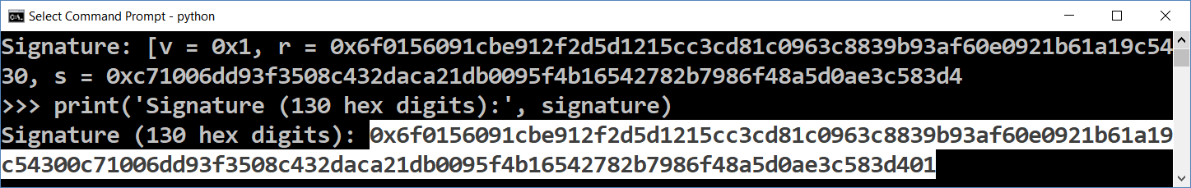
Sign Message in Ethereum – Example
import eth_keys, binascii
privKey = eth_keys.keys.PrivateKey(binascii.unhexlify(
'97ddae0f3a25b92268175400149d65d6887b9cefaf28ea2c078e05cdc15a3c0a'))
print('Private key (64 hex digits):', privKey)
signature = privKey.sign_msg(b'Message for signing')
print('Signature: [v = {0}, r = {1}, s = {2}]'.format(
hex(signature.v), hex(signature.r), hex(signature.s)))
print('Signature (130 hex digits):', signature)

Slide 81
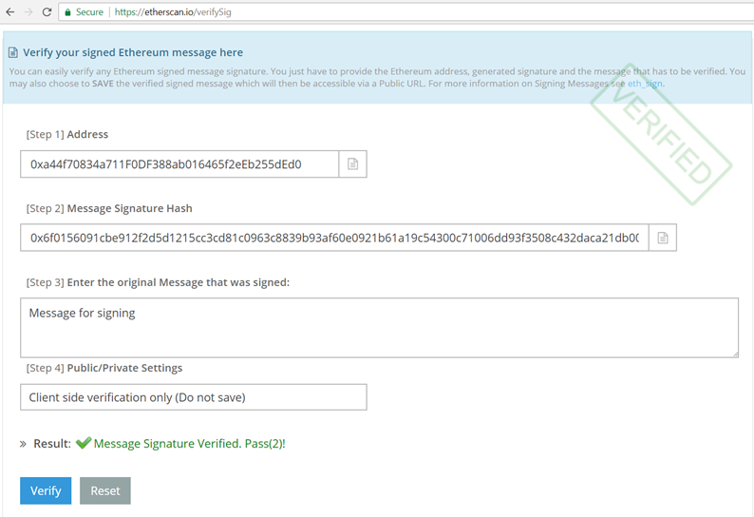
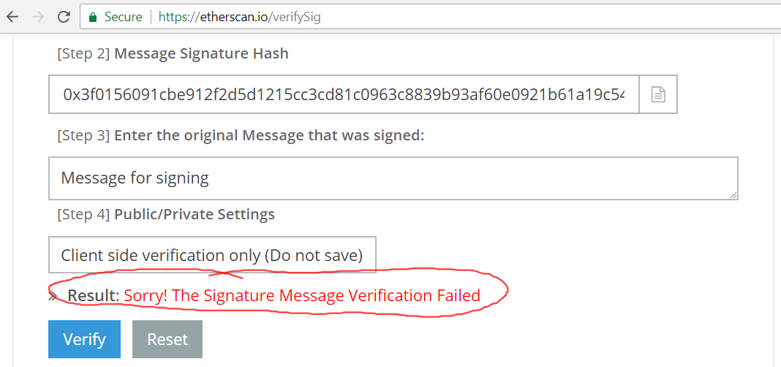
Verify Message Signature in Etherscan
Verify message signature at https://etherscan.io/verifySig by:
signer address (40 hex digits)
signature (130 hex digits)
original message text
The result is: valid / invalid

Slide 82
Verify Ethereum Signature – Example
import eth_keys, binascii
msg = b'Message for signing'
msgSigner = '0xa44f70834a711F0DF388ab016465f2eEb255dEd0'
signature = eth_keys.keys.Signature(binascii.unhexlify( '6f0156091cbe912f2d5d1215cc3cd81c0963c8839b93af60e0921b61a19c54300c71006dd93f3508c432daca21db0095f4b16542782b7986f48a5d0ae3c583d401'))
signerPubKey = signature.recover_public_key_from_msg(msg)
print('Signer public key (recovered):', signerPubKey)
signerAddress = signerPubKey.to_checksum_address()
print('Signer address:', signerAddress)
print('Signature valid?:', signerAddress == msgSigner)

Slide 83
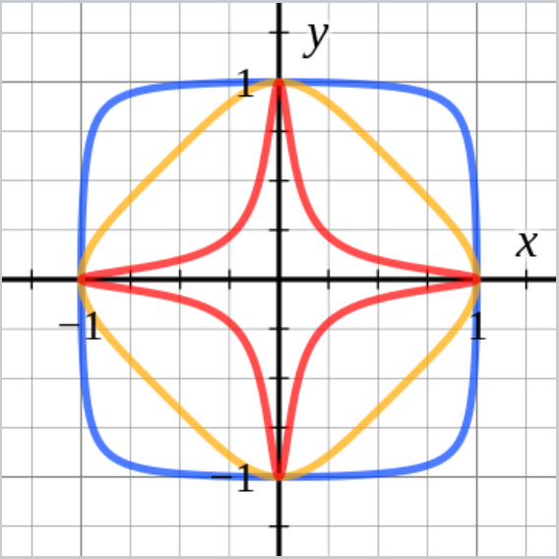

EdDSA and Ed25519
Edwards-curve Digital Signature Algorithm (EdDSA) uses twisted Edwards curves, designed by D. Bernstein and others
Ed25519 is a cryptosystem, based on ECC (elliptic-curve cryptographic) – http://ed25519.cr.yp.to
Uses the Edwards's curve Curve25519 (RFC7748)
EdDSA (using curve25519) is faster than ECDSA (using secp256k1) at similar level of security (even slightly better)

Slide 84
Example: Ed25519 in Python
from pure25519 import ed25519_oop
privKey, pubKey = ed25519_oop.create_keypair()
print("Private key (32 bytes):", privKey.to_ascii(encoding='hex'))
print("Public key (32 bytes): ", pubKey.to_ascii(encoding='hex'))
msg = b'Message for signing'
signature = privKey.sign(msg, encoding='hex')
print("Signature (64 bytes):", signature)
try:
pubKey.verify(signature, msg, encoding='hex')
print("The signature is valid.")
except:
print("Invalid signature!")
pip install pure25519

Slide 85
Exercises
Ethereum: Private Key to Address, Signing Messages and Verifying Signatures

Slide 86


Blockchain Cryptography
Keys, Addresses, Signatures, Wallets

Slide 87
Public Blockchains and Cryptography
Public blockchain networks (like Bitcoin and Ethereum) are mainly based on ECC (elliptic curve cryptography)
Bitcoin, Ethereum, EOS, Tron use ECC with the secp256k1 curve
Ripple, Cardano, Stellar use the Ed25519 ECC cryptosystem
NEO uses ECC with curve secp256r1 (it is similar to secp256k1)
IOTA uses Winternitz hash-based cryptography (quantum-safe)
Monero / CryptoNote use Ed25519 + unique ring signatures
Dash uses ECC with secp256k1 + coin-mixing of transactions

Slide 88
Public / Private Keys, Wallets & Blockchain
wallet master key (seed)
private key
public key
address
signed transaction
transaction data
transaction
sign by private key
signature: (v, r, s)
public key: (x, y)
signed transaction
verify by address
valid / invalid

Slide 89

ECC and Wallets: BIP32
The BIP-32 standard defines how a crypto-wallet can generate multiple keys + addresses
The wallet is initialized by a 256-bit master key (seed)
HMAC + ECC math used to generate multiple accounts
Through a derivation path
E.g. m/44'/60'/1'/12
Each account holds private key → public key → address

Slide 90

Generating an Ethereum Address
Wallet seed S / CSPRNG → private key k → pubic key P → h = Keccak256(P) → Last160bits(h) → address A
Address collision probability = 1 / 2¹⁶⁰

Slide 91

Generating a Bitcoin Address
Wallet seed S / CSPRNG → private key k → pubic key P → WIF compressed public key W → RIPEMD160(SHA256(W)) → address A

Slide 92

Public Key → Bitcoin Address
Generate random private key k
Derive the public key P from it
Pc = CompressPublicKey(P)
hash = RIPEMD160(SHA256(Pc))
Base58CheckEncode(hash, network)
Calculate checksum = SHA256( SHA256(network + hash)) [:4]
Base58Encode (network + hash + checksum)

Slide 93
Generate Bitcoin Address in Python
pip install bitcoin
import bitcoin, hashlib, binascii
def private_key_to_public_key(privKeyHex: str) -> (int, int):
privateKey = int(privKeyHex, 16)
return bitcoin.fast_multiply(bitcoin.G, privateKey)
def pubkey_to_address(pubKey: str, magic_byte = 0) -> str:
pubKeyBytes = binascii.unhexlify(pubKey)
sha256val = hashlib.sha256(pubKeyBytes).digest()
ripemd160val = hashlib.new('ripemd160', sha256val).digest()
return bitcoin.bin_to_b58check(ripemd160val, magic_byte)

Slide 94

Generate Bitcoin Address in Python (2)
private_key = bitcoin.random_key()
print("Private key (hex):", private_key)
public_key = private_key_to_public_key(private_key)
print("Public key (x,y) coordinates:", public_key)
compressed_public_key = bitcoin.compress(public_key)
print("Public key (hex compressed):", compressed_public_key)
address = pubkey_to_address(compressed_public_key)
print("Compressed Bitcoin address (base58check):", address)

Slide 95

Live Demo
Generate a Bitcoin Address: https://www.bitaddress.org

Slide 96
Exercises
Calculating Hashes and Bitcoin Addresses

Slide 97

Merkle Tree
Leaf node == data block
Non-leaf node == cryptographic hash of its child nodes
Efficient and secure verification
Designed to ensure blocks of data can be received from other peers in a peer-to-peer network
Edits and re-organizations are fast

Slide 98

Blockchain and Merkle Trees
Merkle root
The hash of the hashes of all transactions in the block
Block header
Includes also the hash of the previous block’s header
Hashed with a nonce to obtain the PoW value

Slide 99

Post-Quantum Cryptography
Quantum-Resistant Crypto Algorithms

Slide 100
ECC Cryptography is Quantum Unsafe!
A k-bit number can be factored in time of order O(k^3) using a quantum computer of 5k+1 qubits (using Shor's algorithm)
See http://www.theory.caltech.edu/~preskill/pubs/preskill-1996-networks.pdf
256-bit number (e.g. Bitcoin public key) can be factorized using 1281 qubits in 72*256^3 quantum operations
~ 1.2 billion operations == ~ less than 1 second using good machine
ECDSA, DSA, RSA, ElGamal cryptosystems are all quantum-broken
Conclusion: publishing signed transactions (like Ethereum does) is not quantum safe → avoid revealing the ECC public key

Slide 101

Hashes are Quantum Safe
Cryptographic hashes (SHA256 / SHA3) are quantum-safe:
On traditional computer, finding a collision takes $√N$ steps (due to the birthday paradox) → SHA256 has 2¹²⁸ crypto-strength
Quantum computers might find hash collisions in $∛N$ operations (the BHT algorithm), but this is disputed (see [Bernstein 2009])
It might take 2⁸⁵ quantum operations to find SHA256 / SHA3 collision, but in practice it will cost significantly more
Conclusion: SHA256/SHA3-256 are most probably quantum-safe
SHA384, SHA512 and SHA3-384, SHA3-512 are quantum-safe

Slide 102

Symmetric Ciphers are Quantum Safe
AES encryption / most symmetric ciphers are quantum-safe:
Grover's algorithm finds AES secret key in $√N$ quantum operations
Quantum era will double the key size of the symmetric ciphers (see http://cr.yp.to/codes/grovercode-20100303.pdf)
AES-256 in the post-quantum era is like AES-128 before
128-bits or less symmetric ciphers are quantum-attackable
Conclusion: 256-bit symmetric ciphers are quantum safe
AES-256, Twofish-256, Camellia-256 are considered quantum-safe

Slide 103
Post-Quantum Cryptography
Hashes (like SHA256 / SHA3), HMAC, Bcrypt, Scrypt are basically quantum-safe (only slightly affected by quantum computing)
Use 384-bits or more to be quantum-safe (256-bits should be enough for long time)
Symmetric ciphers (like AES-256, Twofish-256) are quantum-safe
Use 256-bits or more as key length (don't use 128-bit AES)
RSA, DSA, ECDSA, DHKE are quantum-broken!
Use quantum-safe signatures (e.g. lattice-based or hash-based)
See https://en.wikipedia.org/wiki/Post-quantum_cryptography

Slide 104

Summary
Cryptography is a method of storing and transmitting data in a secure way
Cryptographic hash function is one-way function, irreversible, almost no collisions
Examples: SHA-256, RIPEMD-160, SHA-3, Keccak-256
Scrypt / Argon2 are recommended for key-derivation
Public / private key cryptography is widely used in the blockchain technologies
ECDSA is elliptic curve cryptosystem: sign / verify

Slide 105
Blockchain Cryptography
http://www.kingsland.academy

